Slide 1
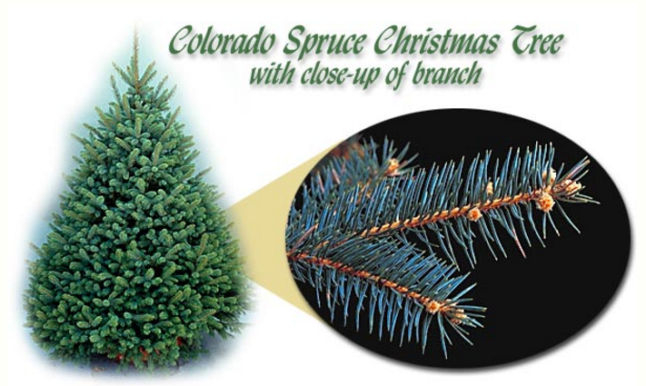
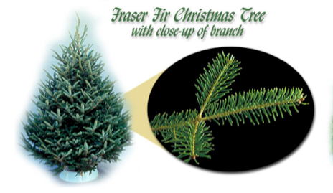
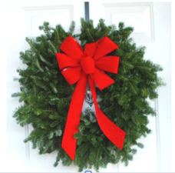
Vail Butlers
Christmas Trees and Wreaths Delivered, set-up & decorated
3ft - $275
6ft - $650
7ft - $750
8ft - $875
9ft - $1,050
10ft - $1,250
12ft – 1,500
3ft - $300
6ft - $700
7ft - $800
8ft - $925
9ft - $1,150
10ft - $1,350
12ft – 1,600
24” – $125
Artificial Trees 7.5ft - $550 9ft - $750 12ft - $875
Prices include all trees and wreaths delivered, set-up, decorated, taken down & recycled. You can save a few hundred dollars if you bring your own decorations.
Please call 970-333-0588 or Email us at Info@VailButlers.com

